Slide 1


Beyond the amplicon: advancing metagenomics methods
Tyler Faits
Bioinformatics Program
Section of Computational Biomedicine
October 9, 2018
tfaits@bu.edu

Slide 2
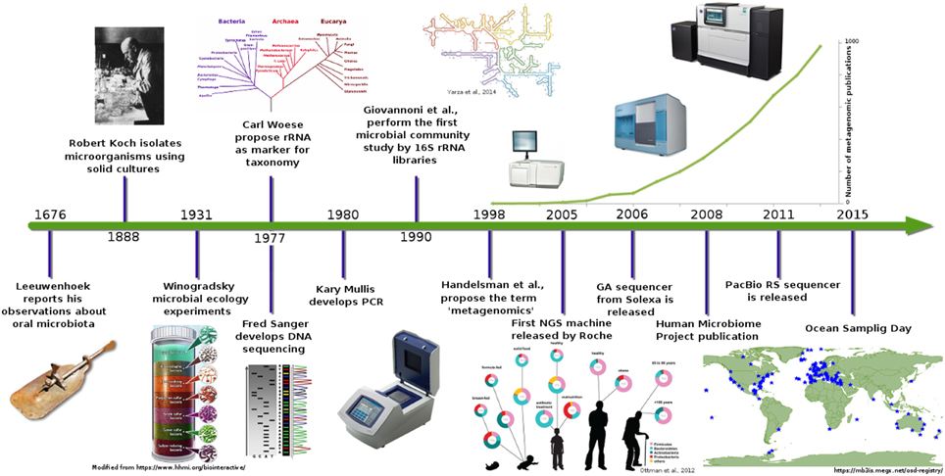

Slide 3
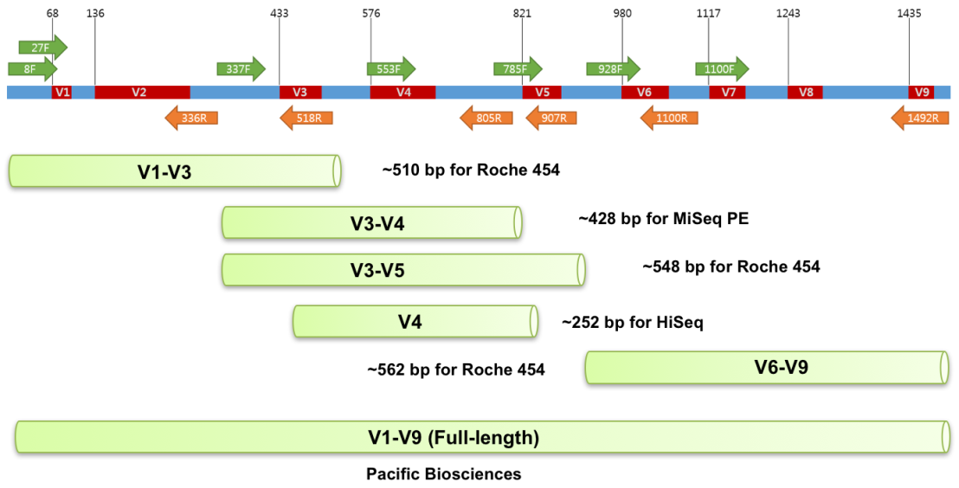
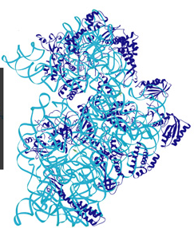
Amplicon Sequencing:
16S rRNA

Slide 4







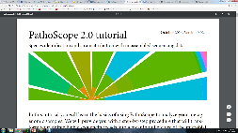


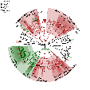
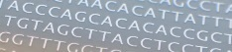




Metagenomics Study
Amplicon
Whole Genome
OUT/Clustering
Reference alignment
Biomarkers
Full Reference
PathoScope
PathoScope
Reference-based
De novo
Amplicon DB
Whole genome
Assembly
Piecemeal
MEGAHIT

Slide 5
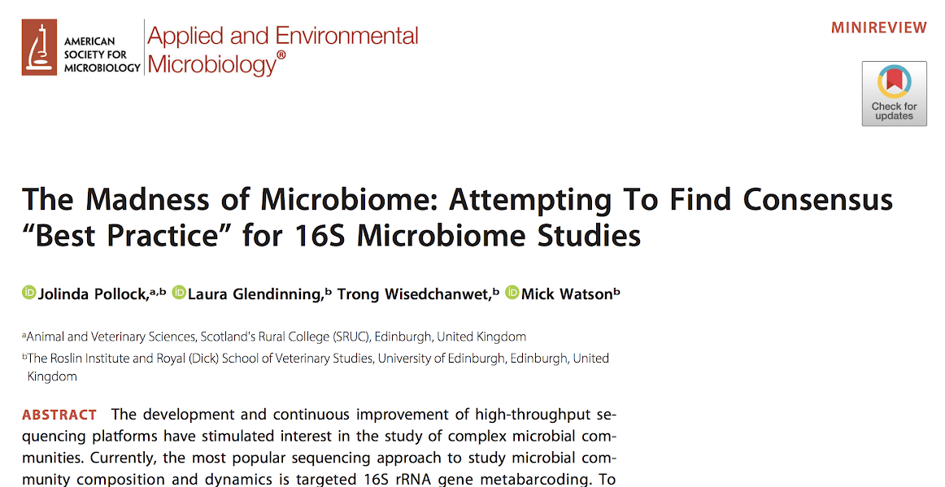

Slide 6
Metagenomics Study
Amplicon
Whole Genome
OTU/Clustering
Reference alignment
Biomarkers
Full Reference
PathoScope
PathoScope
Reference-based
De novo
Amplicon DB
Whole genome
Assembly
Piecemeal
MEGAHIT

Slide 7
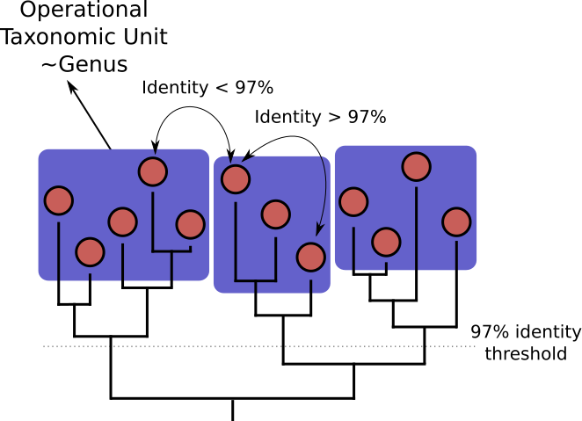
Operational Taxonomic Units

Slide 8
UCLUST Algorithm (and CD-HIT)
Empty Database
Sequencing reads
1
ATCCAATGGCAAAGGACTAAAGAACTTTAAGCGGATTCATGCC
2
ATCAGATGGCCCAGGACTTAAGAACTTAAAGCGAATTCATGAC
3
ATCGGATGGCTAGGGGCTAAAGAACTTTAAGCGGATTCATGCC
4
ATCCAATGGCAAAGGACTAAAGAACTTTAAGCGGATTCATGCC
5
ATCGGATGGCTAGGGGCTAAAGAACTTTAAGCGGATTCATGCC
6
ATCGGATGGCTAGGGGCTAAAGAACTTTAAGCGGATTCATGCC
7
ATCCAATGGCAAAGGACTAAAGAACTTTAAGCGGATTCATGCC
8
ATCAGATGGCCCAGGACTTAAGAACTTAAAGCGAATTCATGAC
9
AAACTATGTCAGGGGACTAAAGAACTTTTAGCAGTTTCATGAC

Slide 9
UCLUST Algorithm (and CD-HIT)
OTU_1
ATCCAATGGCAAAGGACTAAAGAACTTTAAGCGGATTCATGCC
First read becomes a centroid
2
ATCAGATGGCCCAGGACTTAAGAACTTAAAGCGAATTCATGAC
3
ATCGGATGGCTAGGGGCTAAAGAACTTTAAGCGGATTCATGCC
4
ATCCAATGGCAAAGGACTAAAGAACTTTAAGCGGATTCATGCC
5
ATCGGATGGCTAGGGGCTAAAGAACTTTAAGCGGATTCATGCC
6
ATCGGATGGCTAGGGGCTAAAGAACTTTAAGCGGATTCATGCC
7
ATCCAATGGCAAAGGACTAAAGAACTTTAAGCGGATTCATGCC
8
ATCAGATGGCCCAGGACTTAAGAACTTAAAGCGAATTCATGAC
9
AAACTATGTCAGGGGACTAAAGAACTTTTAGCAGTTTCATGAC
10
AAACTATGTCAGGGGACTAAAGAACTTTTAGCAGTTTCATGAC

Slide 10
UCLUST Algorithm (and CD-HIT)
OTU_1
ATCCAATGGCAAAGGACTAAAGAACTTTAAGCGGATTCATGCC
2
ATCAGATGGCCCAGGACTTAAGAACTTAAAGCGAATTCATGAC
X
3
ATCGGATGGCTAGGGGCTAAAGAACTTTAAGCGGATTCATGCC
Align next read to each centroid in the DB, sequentially
If >97% identity, it is assigned to that cluster
4
ATCCAATGGCAAAGGACTAAAGAACTTTAAGCGGATTCATGCC
5
ATCGGATGGCTAGGGGCTAAAGAACTTTAAGCGGATTCATGCC
6
ATCGGATGGCTAGGGGCTAAAGAACTTTAAGCGGATTCATGCC
7
ATCCAATGGCAAAGGACTAAAGAACTTTAAGCGGATTCATGCC
8
ATCAGATGGCCCAGGACTTAAGAACTTAAAGCGAATTCATGAC
9
AAACTATGTCAGGGGACTAAAGAACTTTTAGCAGTTTCATGAC
10
AAACTATGTCAGGGGACTAAAGAACTTTTAGCAGTTTCATGAC

Slide 11
UCLUST Algorithm (and CD-HIT)
OTU_1
ATCCAATGGCAAAGGACTAAAGAACTTTAAGCGGATTCATGCC
OTU_2
ATCAGATGGCCCAGGACTTAAGAACTTAAAGCGAATTCATGAC
3
ATCGGATGGCTAGGGGCTAAAGAACTTTAAGCGGATTCATGCC
If no match is found, the read becomes a new centroid for its own OTU
4
ATCCAATGGCAAAGGACTAAAGAACTTTAAGCGGATTCATGCC
5
ATCGGATGGCTAGGGGCTAAAGAACTTTAAGCGGATTCATGCC
6
ATCGGATGGCTAGGGGCTAAAGAACTTTAAGCGGATTCATGCC
7
ATCCAATGGCAAAGGACTAAAGAACTTTAAGCGGATTCATGCC
8
ATCAGATGGCCCAGGACTTAAGAACTTAAAGCGAATTCATGAC
9
AAACTATGTCAGGGGACTAAAGAACTTTTAGCAGTTTCATGAC
10
AAACTATGTCAGGGGACTAAAGAACTTTTAGCAGTTTCATGAC

Slide 12
UCLUST Algorithm (and CD-HIT)
OTU_1
ATCCAATGGCAAAGGACTAAAGAACTTTAAGCGGATTCATGCC
3
ATCGGATGGCTAGGGGCTAAAGAACTTTAAGCGGATTCATGCC
X
OTU_2
ATCAGATGGCCCAGGACTTAAGAACTTAAAGCGAATTCATGAC
4
ATCCAATGGCAAAGGACTAAAGAACTTTAAGCGGATTCATGCC
5
ATCGGATGGCTAGGGGCTAAAGAACTTTAAGCGGATTCATGCC
6
ATCGGATGGCTAGGGGCTAAAGAACTTTAAGCGGATTCATGCC
Repeat
7
ATCCAATGGCAAAGGACTAAAGAACTTTAAGCGGATTCATGCC
8
ATCAGATGGCCCAGGACTTAAGAACTTAAAGCGAATTCATGAC
9
AAACTATGTCAGGGGACTAAAGAACTTTTAGCAGTTTCATGAC
10
AAACTATGTCAGGGGACTAAAGAACTTTTAGCAGTTTCATGAC

Slide 13
UCLUST Algorithm (and CD-HIT)
OTU_1
ATCCAATGGCAAAGGACTAAAGAACTTTAAGCGGATTCATGCC
OTU_2
ATCAGATGGCCCAGGACTTAAGAACTTAAAGCGAATTCATGAC
4
ATCCAATGGCAAAGGACTAAAGAACTTTAAGCGGATTCATGCC
3
ATCGGATGGCTAGGGGCTAAAGAACTTTAAGCGGATTCATGCC
X
5
ATCGGATGGCTAGGGGCTAAAGAACTTTAAGCGGATTCATGCC
6
ATCGGATGGCTAGGGGCTAAAGAACTTTAAGCGGATTCATGCC
Repeat
7
ATCCAATGGCAAAGGACTAAAGAACTTTAAGCGGATTCATGCC
8
ATCAGATGGCCCAGGACTTAAGAACTTAAAGCGAATTCATGAC
9
AAACTATGTCAGGGGACTAAAGAACTTTTAGCAGTTTCATGAC
10
AAACTATGTCAGGGGACTAAAGAACTTTTAGCAGTTTCATGAC

Slide 14
UCLUST Algorithm (and CD-HIT)
OTU_1
ATCCAATGGCAAAGGACTAAAGAACTTTAAGCGGATTCATGCC
OTU_2
ATCAGATGGCCCAGGACTTAAGAACTTAAAGCGAATTCATGAC
4
ATCCAATGGCAAAGGACTAAAGAACTTTAAGCGGATTCATGCC
5
ATCGGATGGCTAGGGGCTAAAGAACTTTAAGCGGATTCATGCC
OTU_3
ATCGGATGGCTAGGGGCTAAAGAACTTTAAGCGGATTCATGCC
6
ATCGGATGGCTAGGGGCTAAAGAACTTTAAGCGGATTCATGCC
7
ATCCAATGGCAAAGGACTAAAGAACTTTAAGCGGATTCATGCC
8
ATCAGATGGCCCAGGACTTAAGAACTTAAAGCGAATTCATGAC
Repeat
9
AAACTATGTCAGGGGACTAAAGAACTTTTAGCAGTTTCATGAC
10
AAACTATGTCAGGGGACTAAAGAACTTTTAGCAGTTTCATGAC

Slide 15
UCLUST Algorithm (and CD-HIT)
OTU_1
ATCCAATGGCAAAGGACTAAAGAACTTTAAGCGGATTCATGCC
4
ATCCAATGGCAAAGGACTAAAGAACTTTAAGCGGATTCATGCC
√
OTU_2
ATCAGATGGCCCAGGACTTAAGAACTTAAAGCGAATTCATGAC
5
ATCGGATGGCTAGGGGCTAAAGAACTTTAAGCGGATTCATGCC
OTU_3
ATCGGATGGCTAGGGGCTAAAGAACTTTAAGCGGATTCATGCC
6
ATCGGATGGCTAGGGGCTAAAGAACTTTAAGCGGATTCATGCC
7
ATCCAATGGCAAAGGACTAAAGAACTTTAAGCGGATTCATGCC
8
ATCAGATGGCCCAGGACTTAAGAACTTAAAGCGAATTCATGAC
9
AAACTATGTCAGGGGACTAAAGAACTTTTAGCAGTTTCATGAC
Repeat
10
AAACTATGTCAGGGGACTAAAGAACTTTTAGCAGTTTCATGAC

Slide 16
UCLUST Algorithm (and CD-HIT)
Read 4 is now a member of OTU_1
OTU_1
ATCCAATGGCAAAGGACTAAAGAACTTTAAGCGGATTCATGCC
4
OTU_2
ATCAGATGGCCCAGGACTTAAGAACTTAAAGCGAATTCATGAC
5
ATCGGATGGCTAGGGGCTAAAGAACTTTAAGCGGATTCATGCC
OTU_3
ATCGGATGGCTAGGGGCTAAAGAACTTTAAGCGGATTCATGCC
6
ATCGGATGGCTAGGGGCTAAAGAACTTTAAGCGGATTCATGCC
7
ATCCAATGGCAAAGGACTAAAGAACTTTAAGCGGATTCATGCC
8
ATCAGATGGCCCAGGACTTAAGAACTTAAAGCGAATTCATGAC
9
AAACTATGTCAGGGGACTAAAGAACTTTTAGCAGTTTCATGAC
10
AAACTATGTCAGGGGACTAAAGAACTTTTAGCAGTTTCATGAC

Slide 17
UCLUST Algorithm (and CD-HIT)
OTU_1
ATCCAATGGCAAAGGACTAAAGAACTTTAAGCGGATTCATGCC
4,7
OTU_2
ATCAGATGGCCCAGGACTTAAGAACTTAAAGCGAATTCATGAC
8
Each read is either assigned to a cluster or becomes a new centroid
OTU_3
ATCGGATGGCTAGGGGCTAAAGAACTTTAAGCGGATTCATGCC
5,6
OTU_4
AAACTATGTCAGGGGACTAAAGAACTTTTAGCAGTTTCATGAC
10

Slide 18
Metagenomics Study
Amplicon
Whole Genome
OUT/Clustering
Reference alignment
Biomarkers
Full Reference
PathoScope
PathoScope
Reference-based
De novo
Amplicon DB
Whole genome
Assembly
Piecemeal
MEGAHIT

Slide 19

Direct Phylotyping

Slide 20
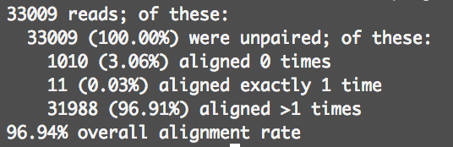
Ambiguous alignments

Slide 21
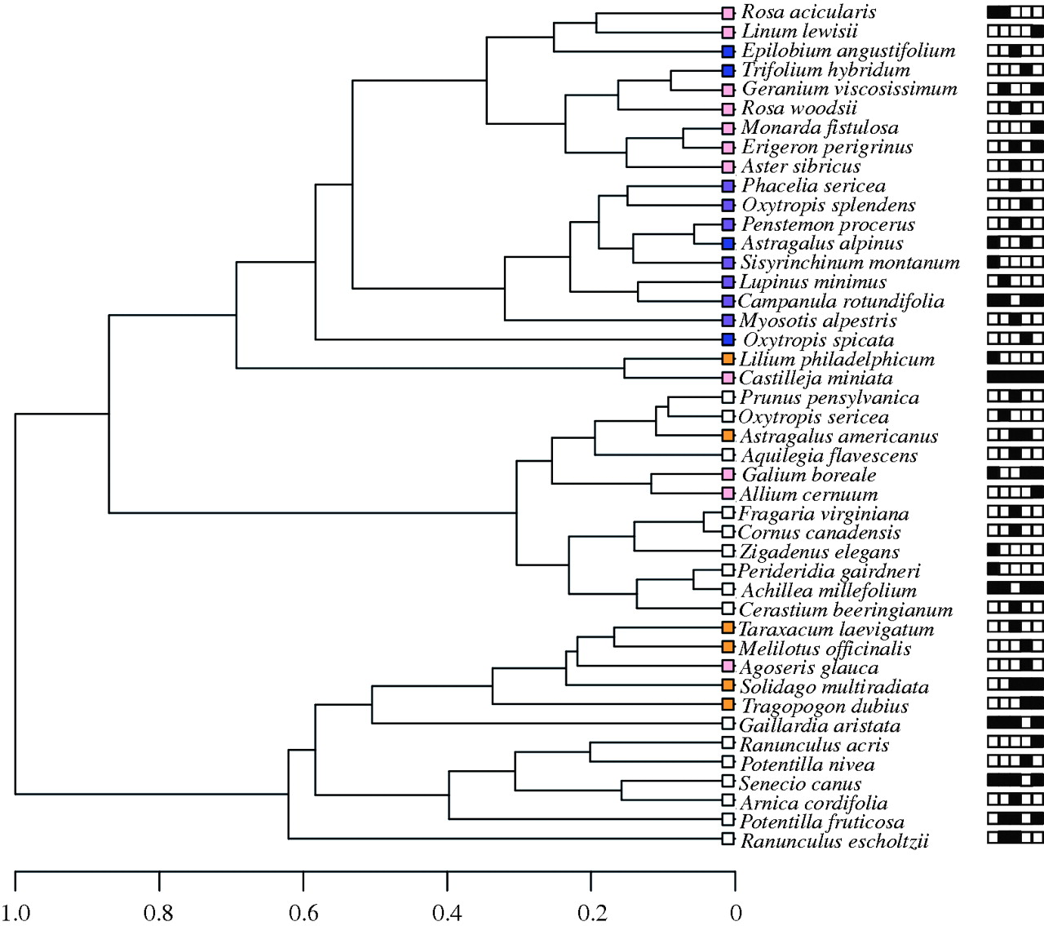
When do ambiguous alignments appear?
Species 1
C
A
T
T
T
A
G
G
T
C
C
A
G
Species 2
C
A
T
T
T
A
G
A
G
T
C
C
A
G
Species 3
C
A
T
T
T
A
G
T
G
T
C
C
A
G
Low-diversity clade

Slide 22
When do ambiguous alignments appear?
Species 1
C
A
T
T
T
A
G
G
T
C
C
A
G
Species 2
C
A
T
T
T
A
G
A
G
T
C
C
A
G
Species 3
C
A
T
T
T
A
G
T
G
T
C
C
A
G
Unknown read
C
A
T
T
T
A
G
T
G
T
C
C
A
A
G

Slide 23
Oversight in 16S databases
16S gene
Different species have different copy numbers of 16S rDNA
16S gene

Slide 24
Oversight in 16S databases
…and each copy has a unique sequence!

Slide 25
Metagenomics Study
Amplicon
Whole Genome
OUT/Clustering
Reference alignment
Biomarkers
Full Reference
PathoScope
PathoScope
Reference-based
De novo
Amplicon DB
Whole genome
Assembly
Piecemeal
MEGAHIT

Slide 26
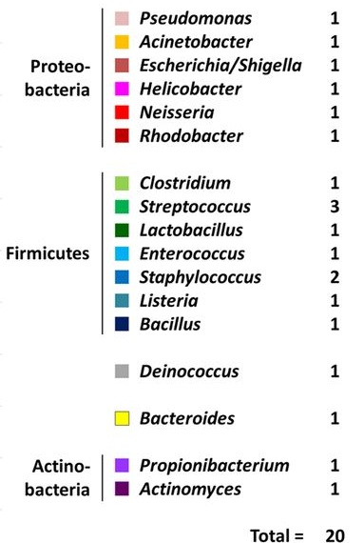
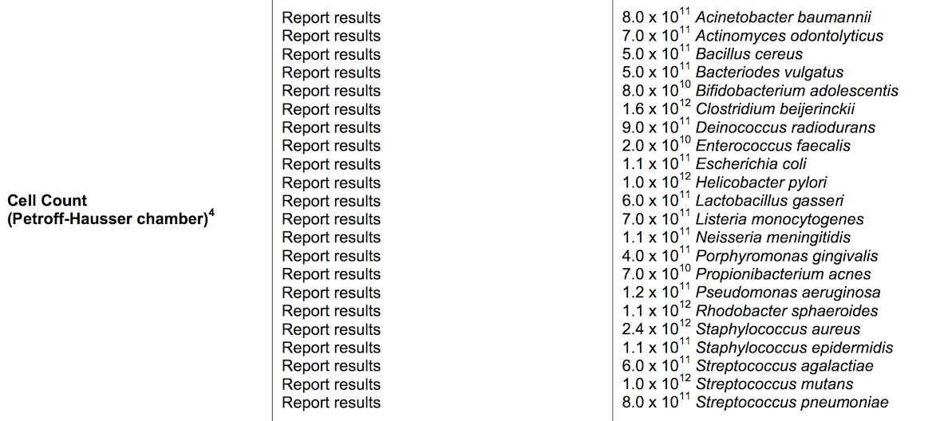
Ground truth: Mock communities
BEI Mock Community B
(Spike-ins)
BEI Mock Community C
(Cells)

Slide 27
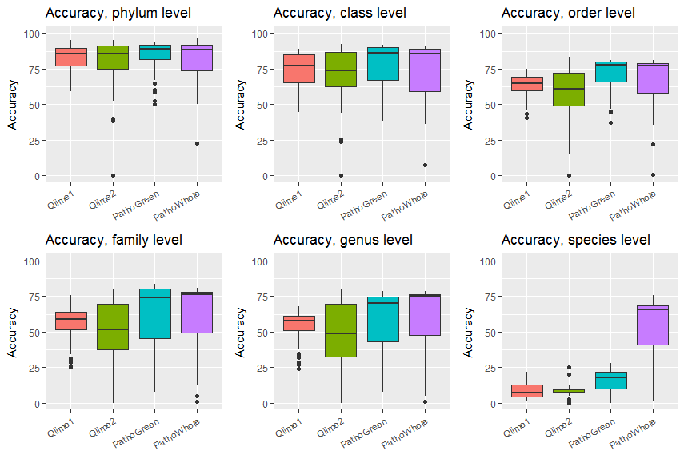
Overall accuracy
in mock communities

Slide 28
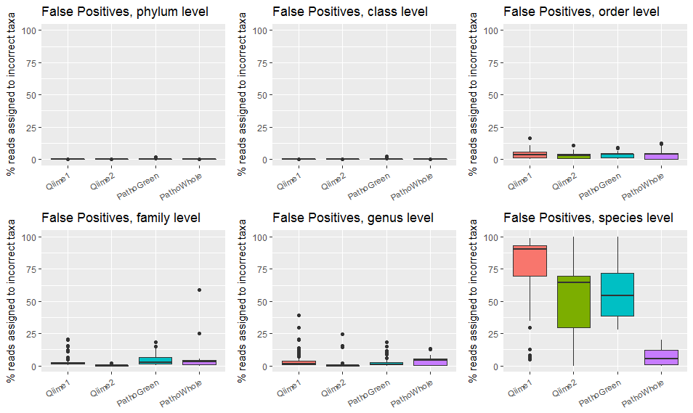
False positive rates
in mock communities

Slide 29
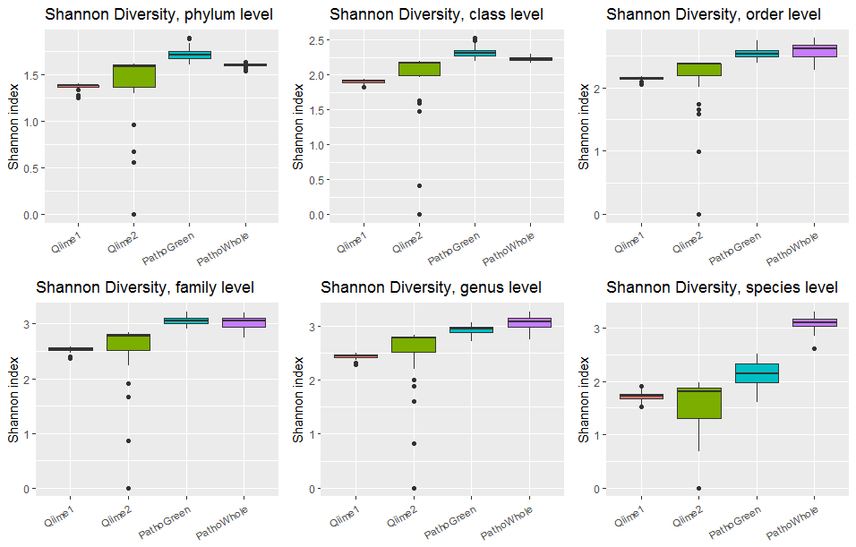
Alpha Diversity
in mock communities

Slide 30
Conclusions
Historic assumptions of 16S amplicon analyses may not hold up:
- Species-level assignments are possible and accurate
- Percent identity cutoffs do not match biological heterogeneity
- Newer OTU-based methods do not empirically improve on older methods
- Whole-genome sequencing and analysis continues to become more feasible
Widely used amplicon reference databases may underperform
With the number of tools and pipelines available for metagenomics analyses, investigators should be judicious and purposeful in their experimental design

Slide 31

Acknowledgements
Johnson Lab:
Evan Johnson
David Jenkins
Yuqing Zhang
Yue (Jason) Zhao
Rotem Lapidot
Qiu Ruan
Lucas Schiffer
Mohammet Khan
Tenglong Li
Zachary Baucom
Ethel Nankya
Lindsey Jung
Tse An Lu
Supriya Sharma
Mani Solaiappan
Thesis Committee:
Evan Johnson
Stefano Monti
Josh Campbell
Daniel Segre
Gary Benson
Lichtentstein Lab, Tufts Medical Center:
Alice Lichtenstein
Nirupa Matthan
Maura Walker
Anne Kane
All staff, faculty, and students with the Section of Comutational Biomedicine

Slide 32
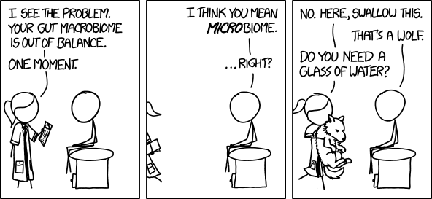

Slide 33











Meta*omics Study
Transcriptomics
Amplicon
Whole Genome
OUT/
Clustering
Reference alignment
Biomarkers
Full Reference
Taxon activity levels
Gene Expression
PathoScope
PathoScope
Reference-based
De novo
Amplicon DB
Whole genome
Assembly
Piecemeal
Direct alignment
Assembly
MEGAHIT
Protein/
Gene DB
Genome DB
HUMAnN
Transcriptomic Imputation

Slide 34
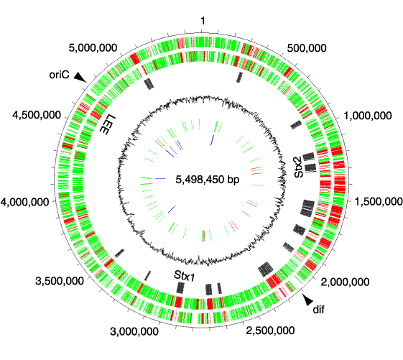
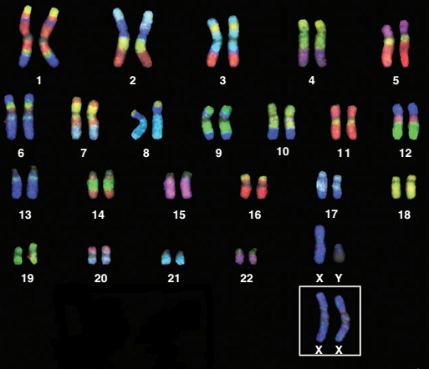
Metatranscriptomics – gene level
Humann genome:
~3,000 Mbp
~20,000 genes
E coli genome:
~5 Mbp
~5,000 genes

Slide 35
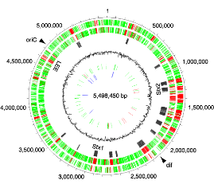
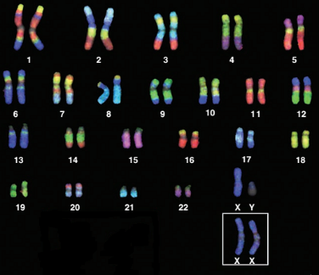

Microbial metagenome:
~150,000 Mbp of reference
>100,000 gene families (for E coli alone!) and counting
Humann genome:
~3,000 Mbp
~20,000 genes

